Slide 1

18ECC303J – Computer Communication Networks
Course Credit : 4
Theory : 9 Hours
1. Behrouz A. Forouzan, “Data communication & Networking”, Mc-Graw Hill, 5th Edition Reprint, 2014.
2. Andrew S. Tanenbaum, “Computer Networks”, Pearson Education India, 5th Edition, 2013.
3. William Stallings, “Data & Computer Communication”, Pearson Education India, 10th Edition, 2014.

Slide 2
Unit 5 – Application Layer
Introduction to Application Layer
Application Layer Paradigms
Client Server Interaction
Session Initiation Protocol (SIP)
Compression Techniques
Introduction to Cryptography
Types, Attacks and Services
DES
RSA
Email, FTP, HTTP
SNMP

Slide 3

Unit 5 – Week 3
Session 11
RSA
Session 12
Email
FTP
Session 13
HTTP
SNMP
Reference Text Books:
1. Behrouz A. Forouzan, “Data communication & Networking”, Mc-Graw Hill, 5th Edition Reprint, 2014.
2. Andrew S. Tanenbaum, “Computer Networks”, Pearson Education India, 5th Edition, 2013.

Slide 4
ASYMMETRIC-KEY CRYPTOGRAPHY - RSA
Objectives :
To compare Symmetric and Asymmetric Encryption
To describe RSA Algorithm with an example
To describe Session Key Encryption

Slide 5
Symmetric Vs Asymmetric Encryption
A single secret key is needed to both encrypt and decrypt a message.
The secret key is possessed by both parties involved in the communication, the sender and the receiver.
Symmetric keys are usually 128 or 256 bits long. The larger the key size, the harder the key is to crack.
Algorithms that use Symmetric Encryption: DES, 3DES , AES, RC4,
Limitations on Symmetric Encryption
Any exposure to the secret key compromises secrecy of ciphertext
A key needs to be delivered to the recipient of the coded message for it to be deciphered
Potential for eavesdropping attack during transmission of key
Asymmetric Encryption
Uses a pair of linked keys
Public key for encryption, Private key for decryption
Messages encoded using public key can only be decoded by the private key, Secret transmission of key for decryption is not required
The public key, is available to everyone who wishes to send a message. On the other hand, the private key is kept at a secure place by the owner of the public key.
Algorithms that use Asymmetric Encryption: RSA, Diffie-Hellman, ECC, DSA.
Courtesy: 101computing.net
Courtesy: 101computing.net

Slide 6
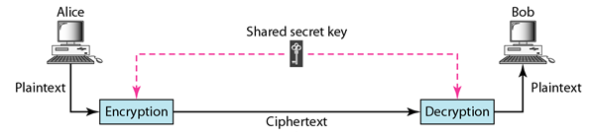
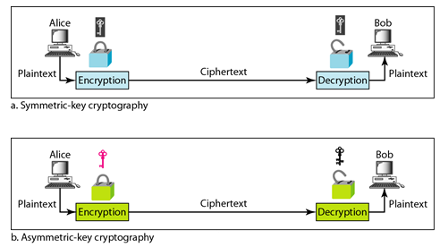
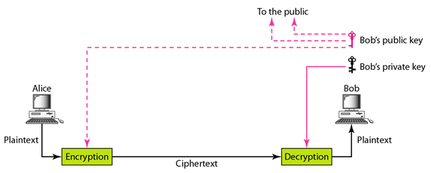
Symmetric and Asymmetric

Slide 7
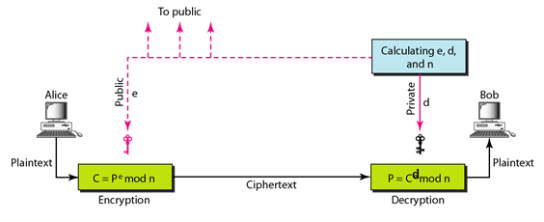
RSA
RSA (Rivest–Shamir–Adleman) : public-key Encryption Algorithm
Developed by Ron Rivest, Adi Shamir, Len Adelman
Widely used for secure data transmission.
Both public and private key are interchangable
Key Size (512, 1024, or 2048 bits)
Most popular public key algorithm
Limitations of Asymmetric Encryption
Efficiency is lower than Symmetric Algorithms
A 1024-bit asymmetric key is equivalent to 128-bit symmetric key
It is problematic to get the key pair generated for the encryption
Very Computationally Intensive

Slide 8
RSA - Basics
Choose two large prime numbers p, q. (e.g., 1024 bits each)
Compute n = p*q, ø(n) = (p-1)(q-1)
Choose e (with 1 < e < ø(n)) that has no common factors with ø(n). (e, and ø(n) are “relatively prime”).
Choose d such that ed-1 is exactly divisible by ø(n). (in other words: ed mod ø(n) = 1 ).
Public key is (e,n). Private key is (d,n).
Given (e,n) and (d,n) as computed above
To encrypt bit pattern, P, compute
C = P^{e} mod n
(i.e., remainder when P^{e} is divided by n)
To decrypt received bit pattern, c, compute
P = C^{d} mod n
(i.e., remainder when c^{d} is divided by n)
RSA Example
Choosing two prime numbers: p=3 & q=11
Computing and ø(n) =(2)*(10) = 20
e = 7 ; [7 and 20 are “relatively prime”]
d = 3 ; [((7x3) –1) is exactly divisible by 20]
Keys generated are
Public key: (7,33)
Private key is (3,33)
In RSA, e and n are announced to the public; d and (p,q) are kept secret.
P=4; C=4^7 mod 33=16
P=16^3mod 33=4

Slide 9
Asymmetric Encryption
Asymmetric Encryption Protocols
Pretty Good Privacy (PGP)
Used to encrypt e-mail using session key encryption
Combines RSA, Triple DES, and other algorithms
Secure/Multipurpose Internet Mail Extension (S/MIME)
Newer algorithm for securing e-mail
Backed by Microsoft, RSA, AOL
Secure Socket Layer(SSL) and Transport Layer Socket(TLS)
Used for securing TCP/IP Traffic
Mainly designed for web use
Can be used for any kind of internet traffic

Slide 10
Session-Key Encryption
Session Key encryption (Used in PGP)
Used to improve efficiency
Encrypts data using a randomly-generated session key and a symmetric encryption algorithm (such as TDES or AES).
Encrypts the session key using a asymmetric encryption algorithm (such as RSA) and include it with the cipher text..
Public-key encryption (such as RSA) creates a public-key encrypted session key using the public key of the recipient and this is sent to recipient along with encrypted data.
Only the recipient can decrypt this data with the corresponding private key.
Cipher
(TDES)
Plain Text
Cipher Text
Send to Recipient
Cipher
(RSA)
Encrypted
Key
Session Key
Recipient’s Public Key

Slide 11
Review Questions
Q1 RSA is a stream cipher
a) True b) False
Q2. In the RSA algorithm, we select 2 random large values ‘p’ and ‘q’. Which of the following is the property of ‘p’ and ‘q’?
a) p and q should be divisible by z
b) p and q should be co-prime
c) p and q should be prime
d) p/q should give no remainder
Q3 In RSA, z = _______ in terms of p and q.
a) (p)/(q)
b) (p)(q)
c) (p-1)(q-1)
d) (p+1)(q+1)
Q4. For p = 11 and q = 19 and choose e=17. Apply RSA algorithm where message=5 and find the cipher text.
a) C=80
b) C=92
c) C=56
d) C=23
Q5. n = 35; d=29, C = 10. What is the plaintext? (use RSA)
a) 3
b) 7
c) 8
d) 5

Slide 12
Answers
1. False
2. p and q should be prime
3. (p-1)(q-1)
4. 80
5. 5

Slide 13
18ECC303J – Computer Communication Networks
_{Course Credit : 4}
_{Theory : 9 Hours}
1. Behrouz A. Forouzan, “Data communication & Networking”, Mc-Graw Hill, 5th Edition Reprint, 2014.
2. Andrew S. Tanenbaum, “Computer Networks”, Pearson Education India, 5th Edition, 2013.
3. William Stallings, “Data & Computer Communication”, Pearson Education India, 10th Edition, 2014.

Slide 14
Unit-5 : Application Layer
Introduction to Application Layer
Application Layer Paradigms
Client Server Interaction
Session Initiation Protocol (SIP)
Compression Techniques
Introduction to Cryptography
Types, Attacks and Services
DES
RSA
Email, FTP, HTTP
SNMP

Slide 15
Objectives
To understand the application layer protocols such as Email and FTP.
To know the various scenarios in Email
To understand the User agent, format of Email
To understand the FTP connections.

Slide 16
Electronic mail (Email)
Electronic mail (or e-mail) allows users to exchange messages.
In an application such as HTTP or FTP, the server program is running all the time, waiting for a request from a client.
When the request arrives, the server provides the service.
There is a request and there is a response.
In the case of electronic mail, the situation is different.
First, e-mail is considered a one-way transaction.

Slide 17
Electronic mail (Email)
When Alice sends an email to Bob, she may expect a response, but this is not a mandate.
Bob may or may not respond. If he does respond, it is another one-way transaction.
Second, it is neither feasible nor logical for Bob to run a server program and wait until someone sends an e-mail to him.
Bob may turn off his computer when he is not using it.
This means that the idea of client/server programming should be implemented in another way: using some intermediate computers (servers).
The users run only client programs when they want and the intermediate servers apply the client/server paradigm.

Slide 18
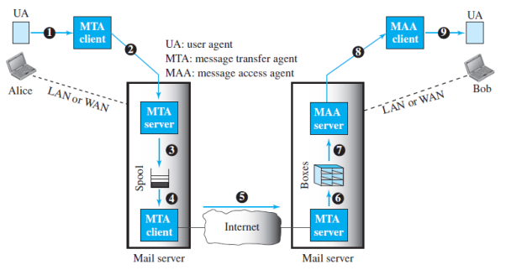
Architecture
To explain the architecture of e-mail, we give a common scenario.
Another possibility is the case in which Alice or Bob is directly connected to the corresponding mail server, in which LAN or WAN connection is not required.
Fig: Common scenario

Slide 19
In the common scenario, the sender and the receiver of the e-mail, Alice and Bob respectively, are connected via a LAN or a WAN to two mail servers.
The administrator has created one mailbox for each user where the received messages are stored.
A mailbox is part of a server hard drive, a special file with permission restrictions. Only the owner of the mailbox has access to it.
The administrator has also created a queue (spool) to store messages waiting to be sent.
A simple e-mail from Alice to Bob takes nine different steps, as shown in the figure. Alice and Bob use three different agents: a user agent (UA), a message transfer agent (MTA), and a message access agent (MAA).

Slide 20
When Alice needs to send a message to Bob, she runs a UA program to prepare the message and send it to her mail server.
The mail server at her site uses a queue (spool) to store messages waiting to be sent.
The message, however, needs to be sent through the Internet from Alice’s site to Bob’s site using an MTA.
Here two message transfer agents are needed: one client and one server. Like most client-server programs on the Internet, the server needs to run all the time because it does not know when a client will ask for a connection.
The client, on the other hand, can be triggered by the system when there is a message in the queue to be sent.
The user agent at the Bob site allows Bob to read the received message.
Bob later uses an MAA client to retrieve the message from an MAA server running on the second server.

Slide 21
There are two important points we need to emphasize here. First, Bob cannot bypass the mail server and use the MTA server directly.
To use the MTA server directly, Bob would need to run the MTA server all the time because he does not know when a message will arrive.
This implies that Bob must keep his computer on all the time if he is connected to his system through a LAN.
If he is connected through a WAN, he must keep the connection up all the time.
Neither of these situations is feasible today. Second, note that Bob needs another pair of client-server programs: message access programs.
This is because an MTA client-server program is a push program: the client pushes the message to the server.
Bob needs a pull program. The client needs to pull the message from the server.

Slide 22
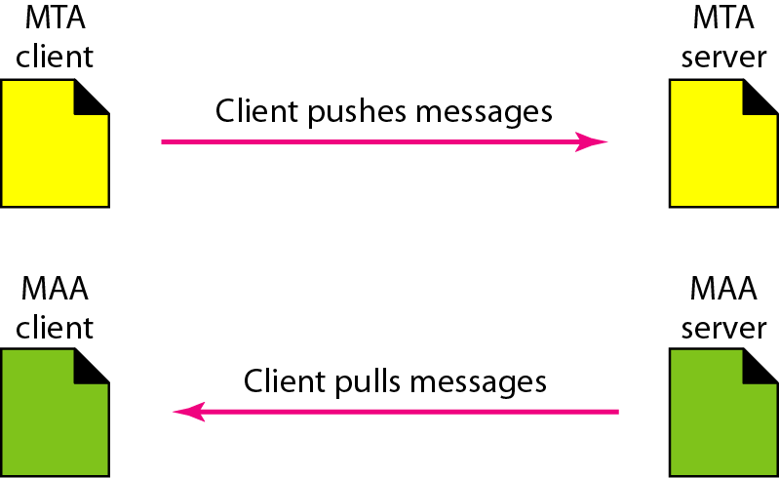
Push versus pull in electronic email

Slide 23
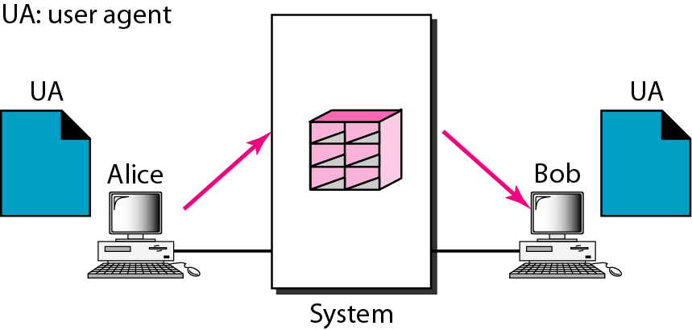
Various scenarios in Email Architecture
First scenario in electronic mail
When the sender and the receiver of an e-mail are on the same system,
we need only two user agents

Slide 24
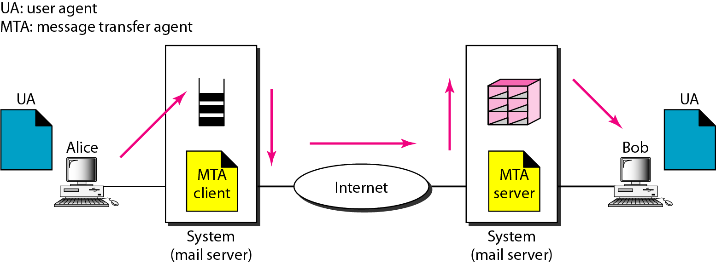
Second scenario in electronic mail
When the sender and the receiver of an e-mail are on different systems, need two UAs and a pair of MTAs (client and server).

Slide 25
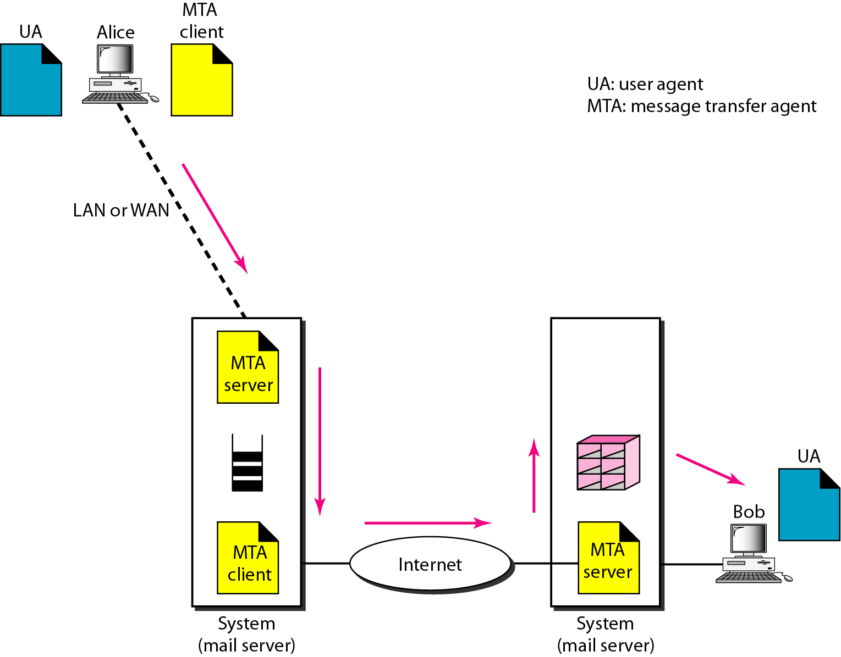
Third scenario in electronic mail
When the sender is connected to the mail server via a LAN or a WAN, need two UAs and two pairs of MTAs (client and server).

Slide 26
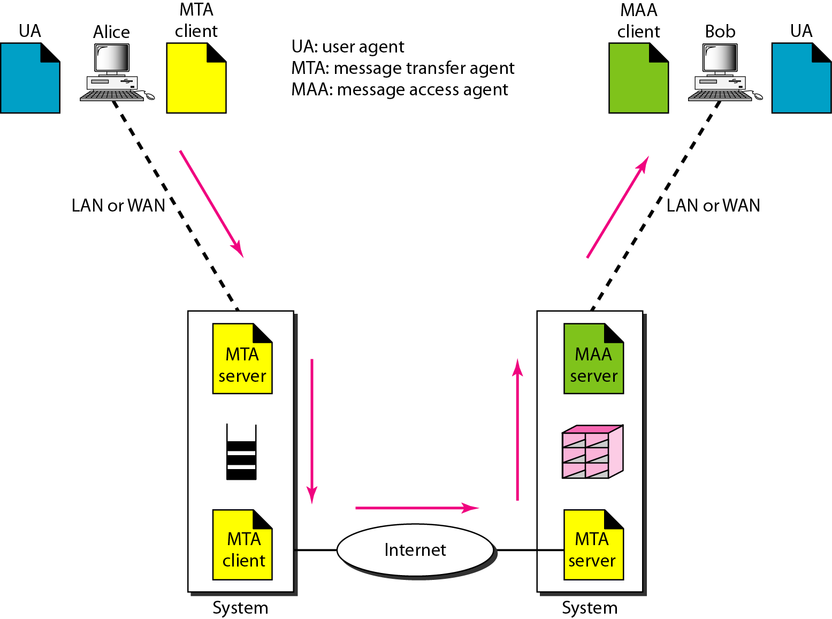
Fourth scenario in electronic mail
When both sender and receiver are connected to the mail server via a LAN or a WAN,
need two UAs, two pairs of MTAs (client and server), and a pair of MAAs
(client and server).

Slide 27
User Agent
The first component of an electronic mail system is the user agent (UA).
It provides service to the user to make the process of sending and receiving a message easier.
A user agent is a software package (program) that composes, reads, replies to, and forwards messages.
It also handles local mailboxes on the user computers.
There are two types of user agents: command-driven and GUI-based.
Command driven user agents belong to the early days of electronic mail. They are still present as the underlying user agents.
A command-driven user agent normally accepts a one character command from the keyboard to perform its task.

Slide 28
For example, a user can type the character r, at the command prompt, to reply to the sender of the message, or type the character R to reply to the sender and all recipients.
Some examples of command driven user agents are mail, pine, and elm.
Modern user agents are GUI-based.
They contain graphical user interface (GUI) components that allow the user to interact with the software by using both the keyboard and the mouse.
They have graphical components such as icons, menu bars, and windows that make the services easy to access.
Some examples of GUI-based user agents are Eudora and Outlook.

Slide 29
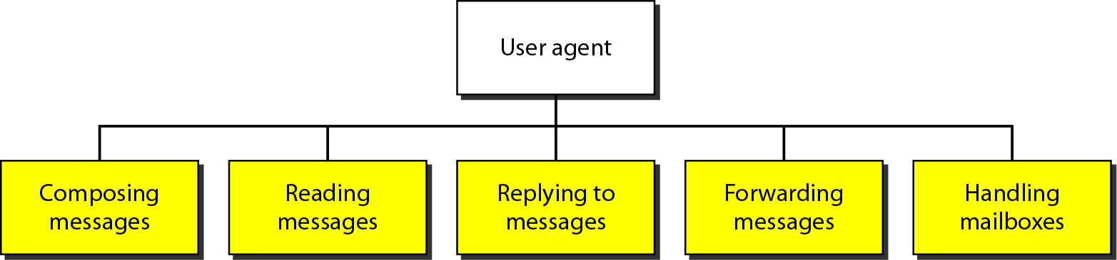
User Agent:
The first component of an electronic mail system is the user agent . It provides
service to the user to make the process of sending and receiving a message easier.
Services of user agent

Slide 30
Sending Mail
To send mail, the user, through the UA, creates mail that looks very similar to postal mail.
It has an envelope and a message.
The envelope usually contains the sender address, the receiver address, and other information.
The message contains the header and the body.
The header of the message defines the sender, the receiver, the subject of the message, and some other information.
The body of the message contains the actual information to be read by the recipient.

Slide 31
Receiving mail
The user agent is triggered by the user (or a timer).
If a user has mail, the UA informs the user with a notice.
If the user is ready to read the mail, a list is displayed in which each line contains a summary of the information about a particular message in the mailbox.
The summary usually includes the sender mail address, the subject, and the time the mail was sent or received.
The user can select any of the messages and display its contents on the screen.

Slide 32
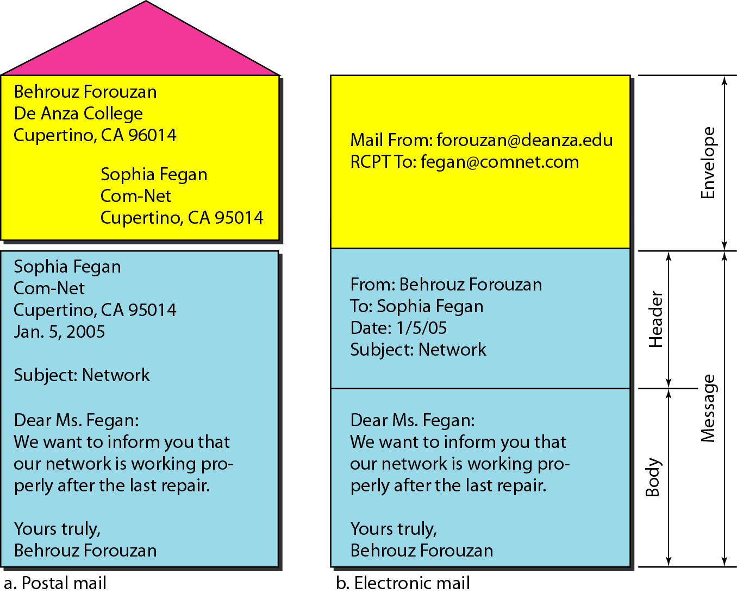
Format of an e-mail

Slide 33
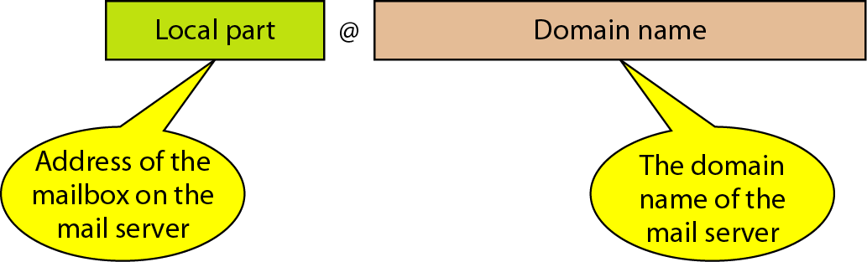
E-mail address

Slide 34
SMTP

Slide 35
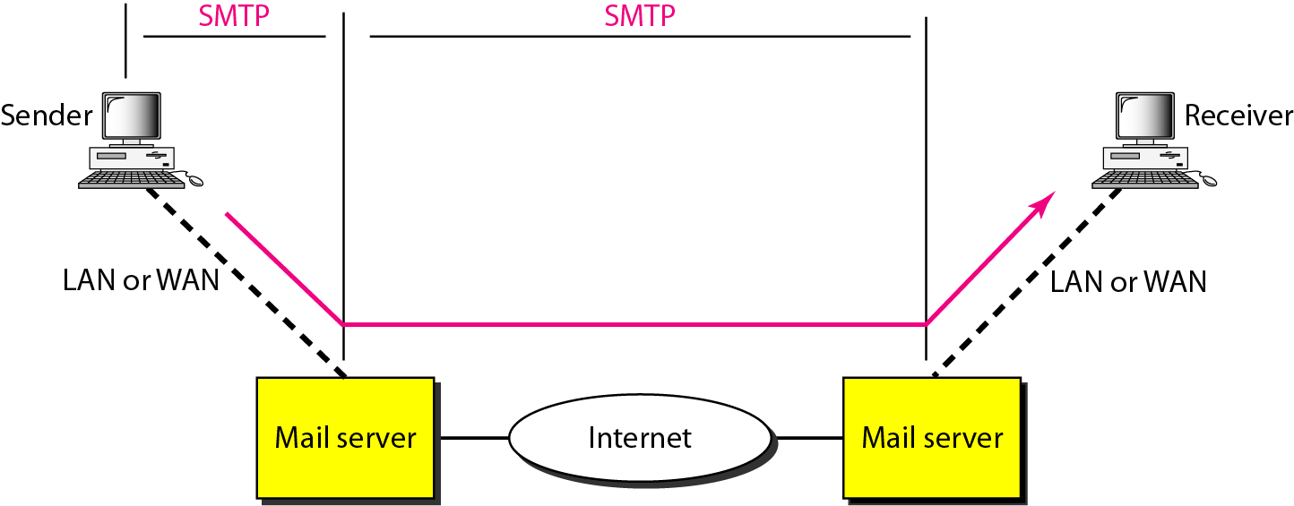
Message Transfer Agent: SMTP
The actual mail transfer is done through message transfer agents. To send mail, a system must have the client MTA, and to receive mail, a system must have a server MTA.
The formal protocol that defines the MTA client and server in the Internet is called the Simple Mail Transfer Protocol (SMTP).
SMTP range

Slide 36
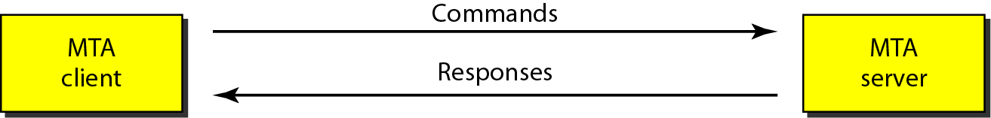

Commands and Responses
SMTP uses commands and responses to transfer messages between an MTA client and an MTA server
Command format

Slide 37
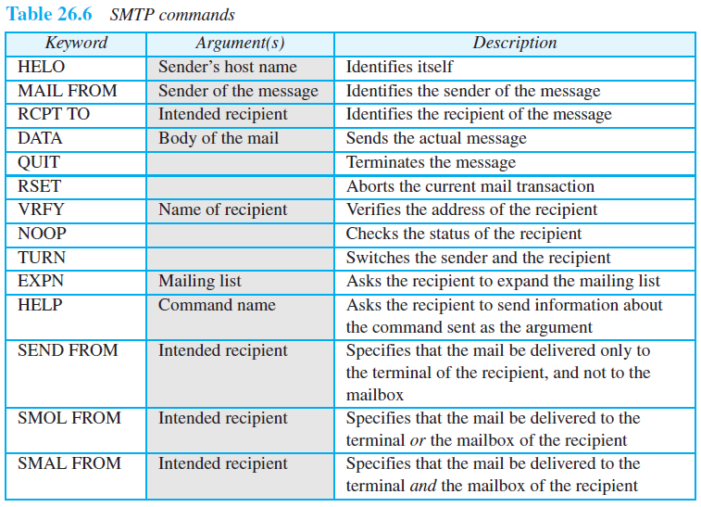
Commands

Slide 38
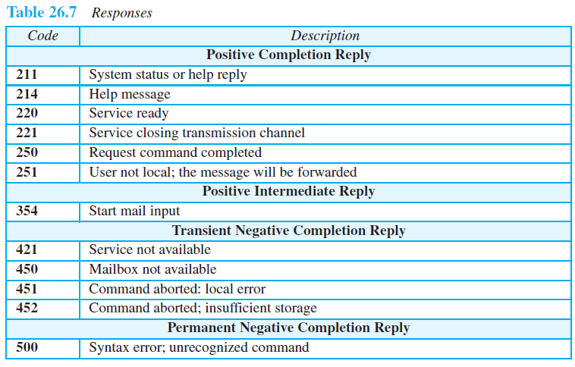
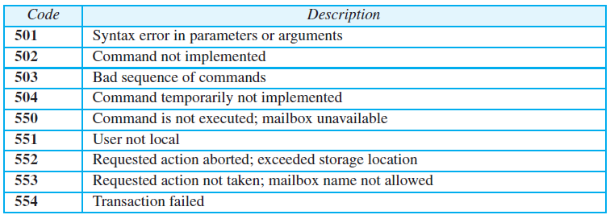
Responses

Slide 39
Example
Let us see how we can directly use SMTP to send an e-mail and simulate the commands and responses we described in this section. We use TELNET to log into port 25 (the well-known port for SMTP).
We then use the commands directly to send an e-mail. In this example, forouzanb@adelphia.net is sending an e-mail to himself.
The first few lines show TELNET trying to connect to the Adelphia mail server.
After connection, we can type the SMTP commands and then receive the responses, as shown on the next slide.
Note that we have added, for clarification, some comment lines, designated by the “=” signs. These lines are not part of the e-mail procedure.

Slide 40
Example (continued)
Mail Transfer Phases
The process of transferring a mail message occurs in three phases: connection establishment, mail transfer, and connection termination.
$ telnet mail.adelphia.net 25
Trying 68.168.78.100 . . .
Connected to mail.adelphia.net (68.168.78.100).

Slide 41
Example (continued)

Slide 42
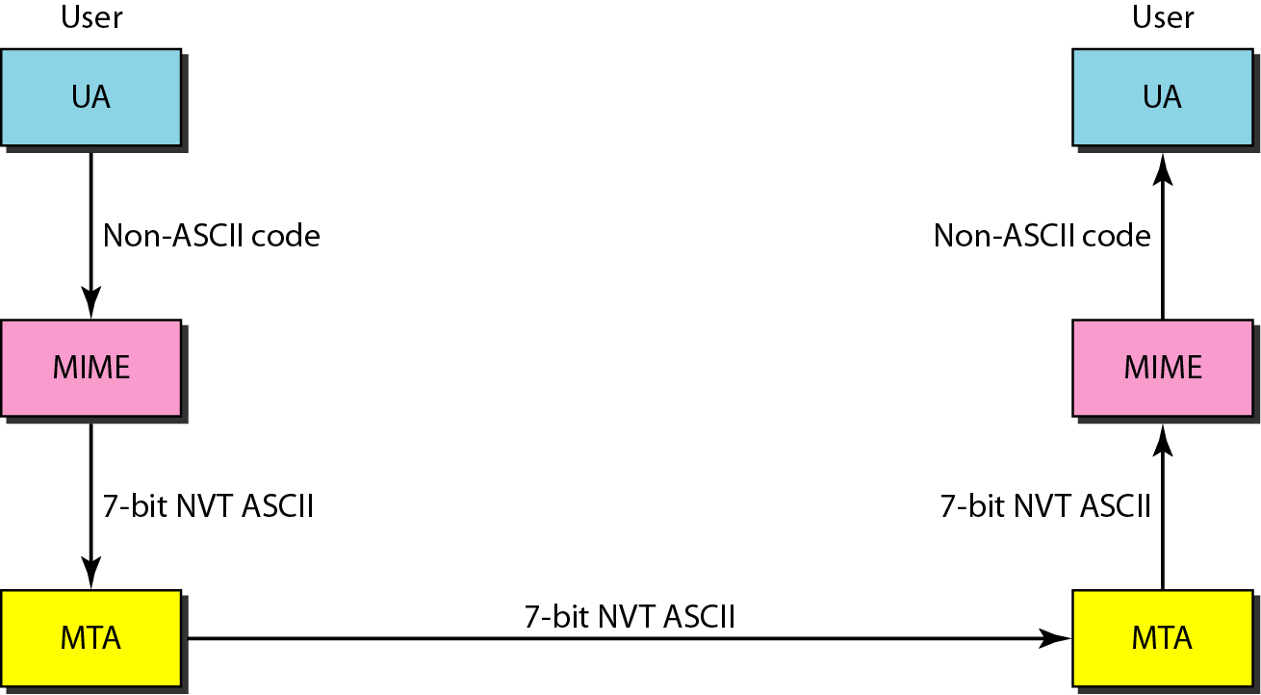
Multipurpose Internet Mail Extensions (MIME)
MIME is a supplementary protocol that allows non-ASCII data to be sent through e-mail.
MIME transforms non-ASCII data at the sender site to NVT ASCII data and delivers them to the client MTA to be sent through the Internet. The message at the receiving side is transformed back to the original data
Figure 26.14 MIME

Slide 43
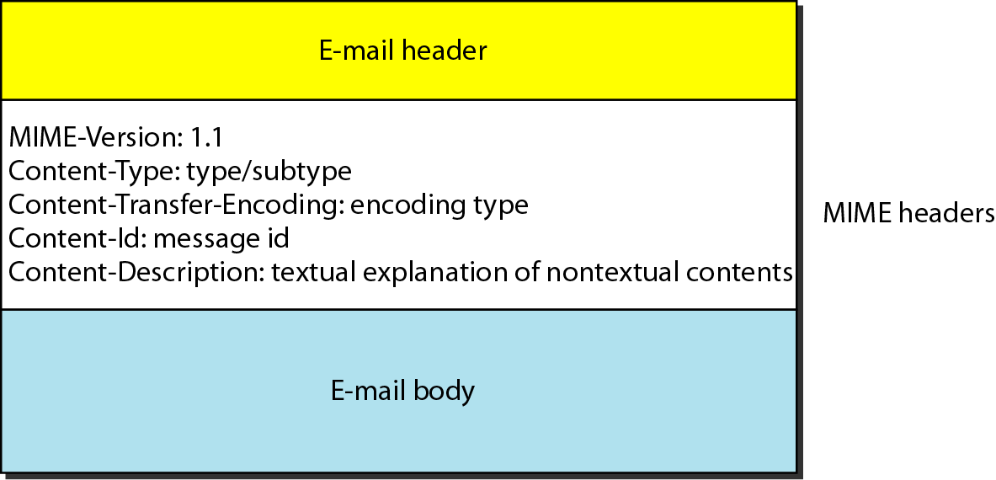
MIME header

Slide 44
Data types and subtypes in MIME

Slide 45

Content-transfer-encoding
Content-Transfer-Encoding This header defines the method used to encode the
messages into Os and Is for transport:

Slide 46
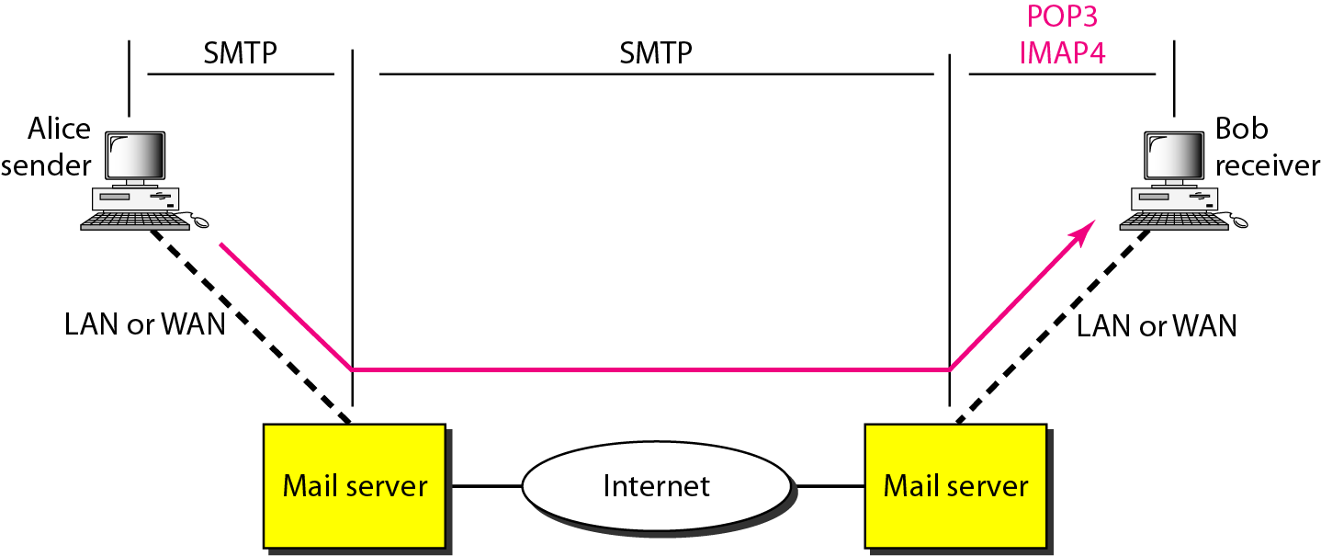
Message Access Agent: POP and IMAP
The first and the second stages of mail delivery use SMTP.
Currently two message access protocols are available: Post Office Protocol, version 3 (POP3) and Internet Mail Access Protocol, version 4 (IMAP4)
POP3 and IMAP4

Slide 47
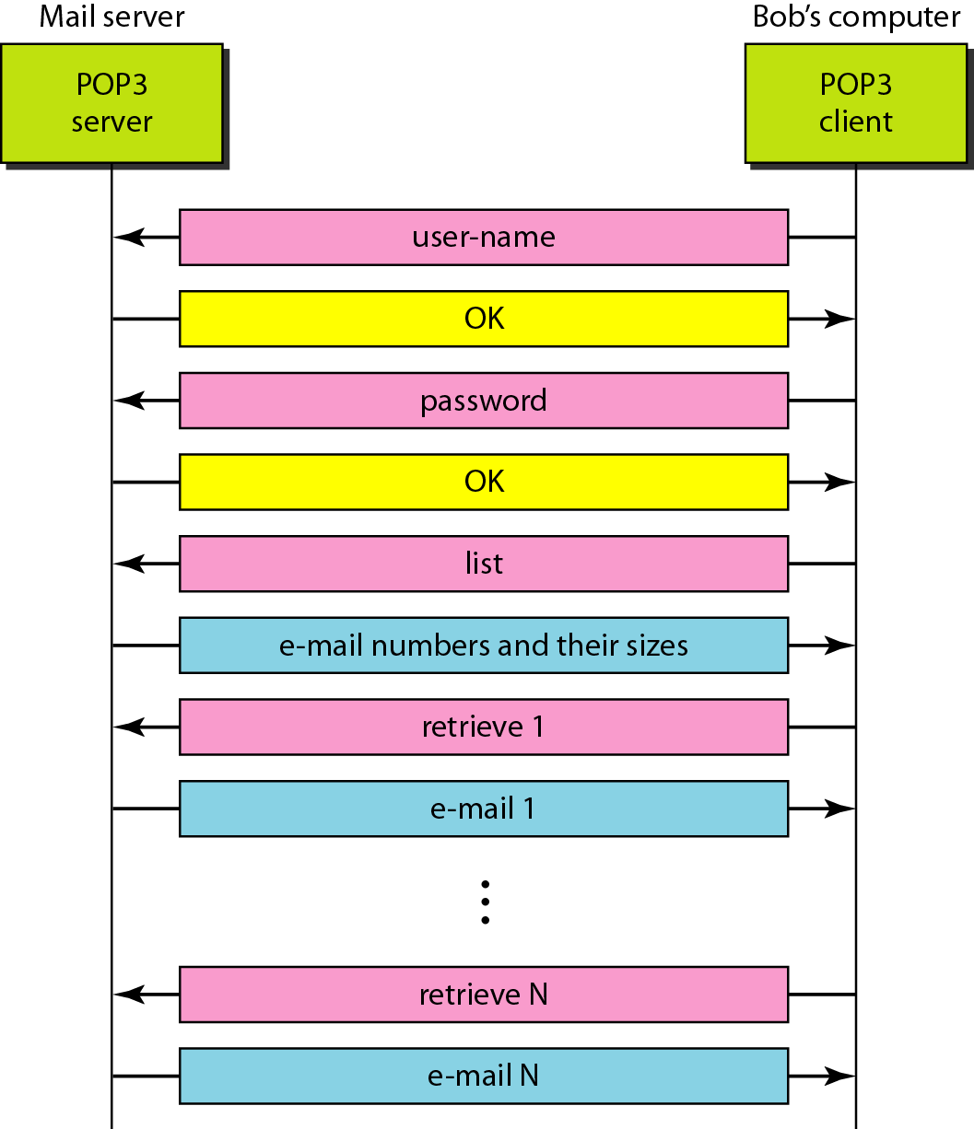
The exchange of commands and responses in POP3

Slide 48
FILE TRANSFER PROTOCOL
File Transfer Protocol (FTP) is the standard mechanism provided by TCP/IP.
It copy's a file from one host to another
Transferring files from one computer to another in networking or internetworking environment.
The following problems may occur while transferring the file between two systems
may use different file name conventions
may have different way to represent text and data
may have different directory structure
All of these problems have been solved by FTP in a very simple and elegant approach.

Slide 49
FILE TRANSFER PROTOCOL
FTP differs from other client-server applications
It establishes two connections between the hosts
One connection is used for data transfer
The other for control information (commands and responses)
Separation of commands and data transfer makes FTP more efficient
The control connection uses very simple rules of communication
We need to transfer only a line of command or a line of response at a time
The data connection needs more complex rules due to the variety of data types transferred

Slide 50
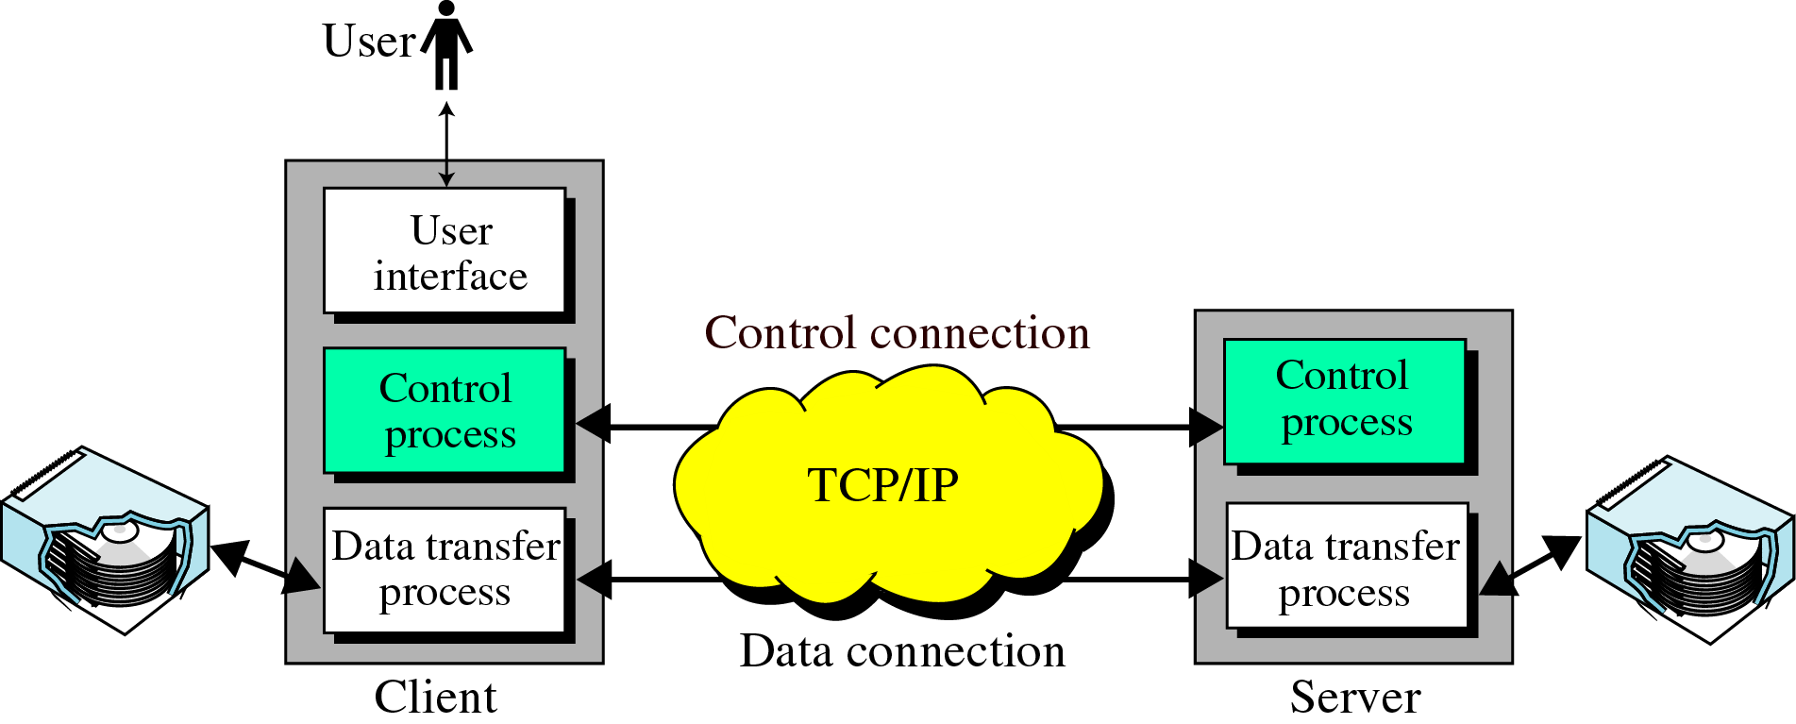
FTP

Slide 51
FTP
The above figure shows the basic model of FTP.
The client has three components
The user interface
The client control process
Client data transfer process
The sever has two components
The sever control process
The server data transfer process
The control connection is made between the control processes
The data connection is make between the data transfer processes

Slide 52
The control connection remains connected during the entire interactive FTP session
The data connection is opened and then closed for each file transferred
It open each time commands that involve transferring files are used and it closes when the file is transferred
The two FTP connections, control and data, use different strategies and different port numbers.

Slide 53
Communication over control connection:
It uses 7 bit ASCII character set. Communication is achieved through command and responses.
We send one command or response at a time.
Each command or response is only one short line, so we need not worry about file format or file structure.
Each line is terminated with a two character ( carriage return and line feed) end of line token.
Communication over Data connection:
File transfer occurs over the data connection under the control of commands sent over the control connection.
Remember that file transfer in FTP means one of three things:
A file is to be copied from the server to the client. This is called retrieving the file. It is done under the supervision of the RETR command

Slide 54
A file is to be copied from the client to the server. This is called storing a file. It is done under the supervision of the STOR command.
A list of directory or file names is to sent from the server to the client. This is done under the supervision of the LIST command. FTP treats a list of directory or file names as a file. It is sent over the data connection.
Note:
Client must define the type of data, structure of the data, and the transmission mode.
Before sending the data through the data connection , we prepare for transmission through the control connection.

Slide 55
A file is to be copied from the client to the server. This is called storing a file. It is done under the supervision of the STOR command.
A list of directory or file names is to sent from the server to the client. This is done under the supervision of the LIST command. FTP treats a list of directory or file names as a file. It is sent over the data connection.
Note:
Client must define the type of data, structure of the data, and the transmission mode.
Before sending the data through the data connection , we prepare for transmission through the control connection.

Slide 56
TRIVIAL FILE TRANSFER PROTOCOL [TFTP]
In some occasions we need to copy a file without any functionalities of FTP
For example – to download the bootstrap and configuration files
For this we need a protocol that quickly copies the files
TFTP is designed for these types of file transfer
This software package can fit into the read only memory of a diskless workstation
It can be used at bootstrap time
TFTP can read or write a file for the client
Reading means copying a file from the server site to the client site
Writing means copying a file from the client site to the server site.

Slide 57
Review Questions
When the sender and the receiver of an e-mail are on the same system, we need _______user agents.
When both sender and receiver are connected to the mail server via a LAN or a WAN, we need ____ UAs, ______ pairs of MTAs (client and server), and _______ pair of MAAs (client and server).
_________ provides service to the user to make the process of sending and receiving a message easier.
The format of an email consist of ______ and ______.
_________ is a supplementary protocol that allows non-ASCII data to be sent through e-mail.
__________ defines the MTA client and server in the Internet.
FTP establishes __________ and __________ connection between the host.
The data connection remains connected during the entire interactive FTP session. (Yes/No).

Slide 58
Answers
Two
Two, two, single
User agent
Envelope and message
MIME
SMTP
Control and data
No

Slide 59
HTTP
Objectives :
To describe HTTP concept
To describe HTTP Message Types: Request and Response
To describe HTTP Header
To define URL
The Hypertext Transfer Protocol (HTTP) is an application-level protocol for distributed, collaborative, hypermedia information systems.
HTTP is a TCP/IP based communication protocol, that is used to deliver data (HTML files, image files, query results, etc.) on the World Wide Web.

Slide 60
HTTP
Hypertext Transfer protocol [HTTP] is a protocol used to access data on the World Wide Web (www)
The protocol transfers data in the form of plaintext, hypertext, audio, video and so on.
It is called hypertext transfer protocol because its efficiency allows its use in a hypertext environment, where there are rapid jumps from one document to another
It provides a standardized way for computers to communicate with each other. HTTP specification specifies how clients' request data will be constructed and sent to the server, and how the servers respond to these requests.
HTTP functions are like a combination of FTP and SMTP. It is similar to FTP because it transfers files and uses the services of TCP. HTTP is much simpler than the FTP because it uses one TCP connection.

Slide 61
Basic Features of HTTP
Connectionless: The HTTP client, i.e., a browser initiates an HTTP request and after a request is made, the client waits for the response. The server processes the request and sends a response back after which client disconnect the connection. So client and server knows about each other during current request and response only.
Media independent: Any type of data can be sent by HTTP as long as both the client and the server know how to handle the data content.
Stateless: The server and client are aware of each other only during a current request. Afterwards, both of them forget about each other. Due to this nature of the protocol, neither the client nor the browser can retain information between different requests across the web pages.

Slide 62
HTTP and SMTP
HTTP is similar to SMTP because the data transferred between the Client and Server look like SMTP message
The format of the message is controlled by MIME(Multipurpose Internet Mail Extension) like headers
HTTP is differ from SMTP – the messages are sent from the Client to the server and from server to the client
Unlike SMTP messages are not destined to be read by humans
HTTP messages are read and interpreted by the HTTP server and HTTP client
SMTP messages are stored and forwarded but HTTP messages are delivered immediately
The commands from the client to the server are embedded in a request message.
The contents of the requested file are embedded in a response message.

Slide 63
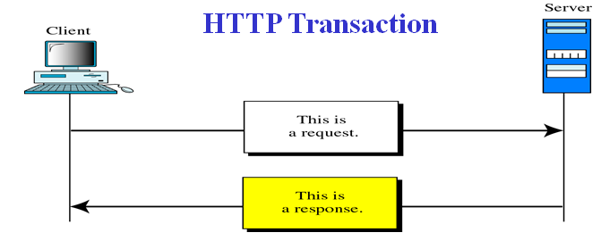
HTTP - Concept
HTTP uses the services of TCP on well known port 80.
The concept of HTTP is simple
A client sends a request – which looks like mail to the server
The server sends the response, which looks like a mail reply to the client
HTTP - stateless protocol, does not require the server to retain session information or status about each communications partner for the duration of multiple requests.
HTTP is a stateless protocol, which means that the connection between the browser and the server is lost once the transaction ends.
The request and response messages carry data in the form of a letter with MIME like format
Commands from the client to server are embedded in a letter like request message
The contents of the requested file of other information are embedded in a letter like response message

Slide 64
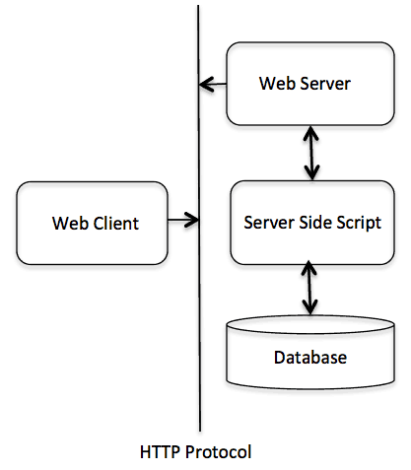
Basic architecture of a web application
The HTTP protocol is a request/response protocol based on the client/server based architecture where web browsers, robots and search engines, etc. act like HTTP clients, and the Web server acts as a server.
Client
The HTTP client sends a request to the server in the form of a request method, URI, and protocol version, followed by a MIME-like message containing request modifiers, client information, and possible body content over a TCP/IP connection.
Server
The HTTP server responds with a status line, including the message's protocol version and a success or error code, followed by a MIME-like message containing server information, entity meta information, and possible entity-body content.

Slide 65
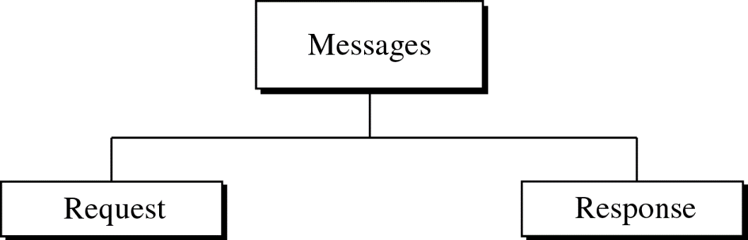
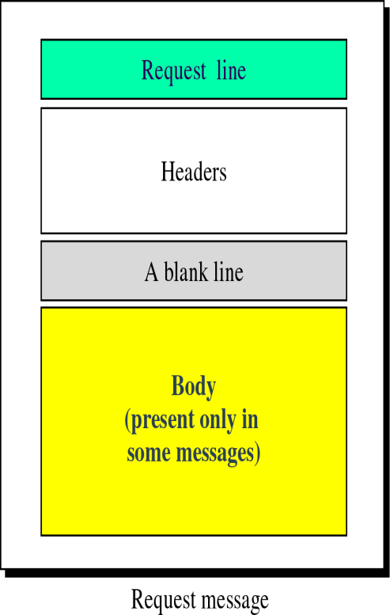
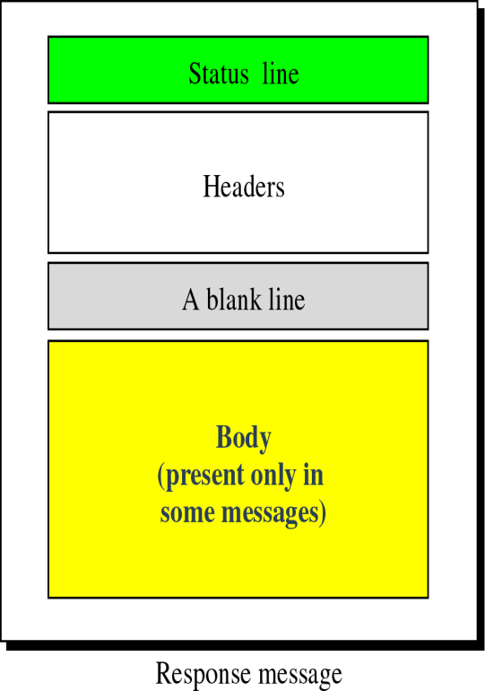
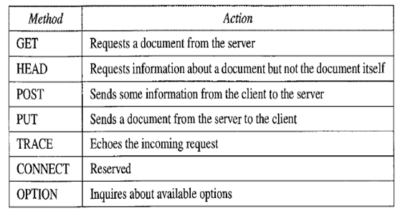
HTTP - Message types
Request and Status line:
The first line in the response message is called status line
The first line in a request message is called request line.
Request type:
This field is used in the request message.
In version 1.1 HTTP, several request types are defined. The request type is categorized into methods as shown in below table.
A request message consists of a request line, headers and some times a body
A response message consists of a status line, headers and some times a body

Slide 66
HTTP – Request Message
Most of the time, the client uses the GET method to send a request. In this case, the body of the message is empty.
The HEAD method is used when the client needs only some information about the web page from the server, such as the last time it was modified. It can also be used to test the validity of a URL.
The response message in this case has only the header section; the body section is empty.
The PUT method is the inverse of the GET method; it allows the client to post a new web page on the server (if permitted).
The POST method is similar to the PUT method, but it is used to send some information to the server to be added to the web page or to modify the web page.
The TRACE method is used for debugging; the client asks the server to echo back the request to check whether the server is getting the requests.
The DELETE method allows the client to delete a web page on the server if the client has permission to do so.
The CONNECT method was originally made as a reserve method; it may be used by proxy servers, as discussed later.
Finally, the OPTIONS method allows the client to ask about the properties of a web page.

Slide 67
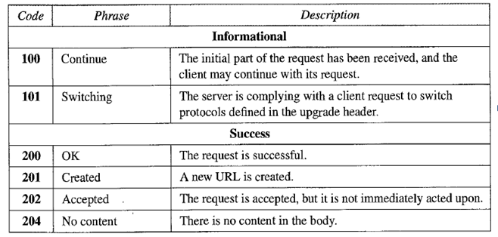
HTTP – Message types
Status code:
This field is used in response message. The status code field is similar to those in the FTP and the SMTP protocols.
It consists of 3 digits.
100 range – only informational;
200 range – successful request
300 range – redirect the client to another URL
400 range – indicate an error at the client site
500 range – indicate an error at the server site
Status phrase:
Used in the response message. It explains the status code in the text form.

Slide 68
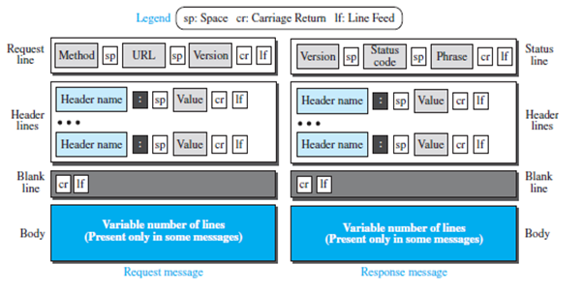
Format of Request and Response messages

Slide 69

HTTP Header
Header
Exchanges additional information between client and server.
Can consist of one or more header lines
Each header line has a header name, a colon, a space and a header value
Request Message: Can contain general, request and entity headers
Response Message: Can contain general , response and entity header
Header categories
General header
Request header
Response header
Entity header
Uniform Resources
URL
Uniform Resource Locator
Refers to an existing protocol
http:, wais:, ftp:, mailto:, gopher:, news:
Points to a document on a specific server
URN
Uniform Resource Name
Globally unique, persistent identifier
Independent of location
URI
Uniform Resource Identifier
Collection of URL’s and URN’s
Courtesy: 101computing.net
Courtesy: 101computing.net

Slide 70
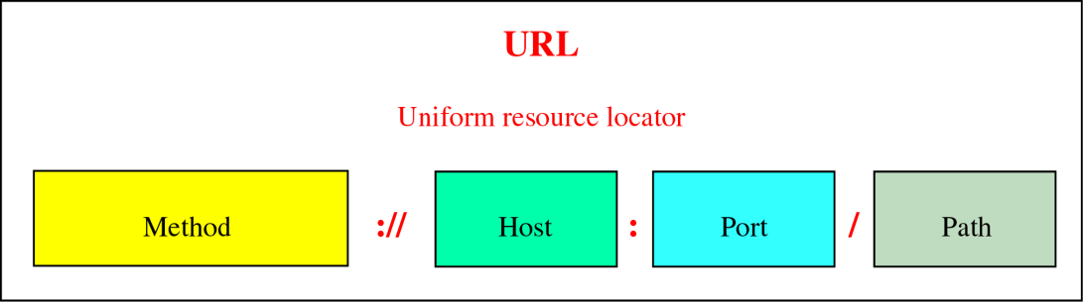
Uniform Resource Locator (URL)
A client that wants to access a web page needs the address.
To facilitate the access of documents distributed throughout the world, http uses locators.
The Uniform Resource Locator (URL) is standard for specifying any kind of information on the internet
URL defines four things (shown above)
Method
Host computer
Port
Path
Method: Client server protocol used to retrieve the document. e.g HTTP
Host: Name of the computer on which the information is located. Web pages are usually stored in computers and computers are given alias names that begin with ‘www’
Port: Optional. Url can contain port numberr of server.
Path: Path of the filename where the inforrmation is located.
Example
The URL http://www.mhhe.com/compsci/forouzan/ defines the web page related to the author Ferouzan
The string www.mhhe.com is the name of the computer in the McGraw-Hill company (the three letters www are part of the host name and are added to the commercial host).
The path is compsci/forouzan/, which defines Forouzan’s web page under the directory compsci (computer science).

Slide 71
Review Questions
Q1 The first line of HTTP request message is called _____________
a) Request line
b) Header line
c) Status line
d) Entity line
Q2The values GET, POST, HEAD etc are specified in ____________ of HTTP message
a) Request line
b) Header line
c) Status line
d) Entity bodyr
Q3 The __________ method when used in the method field, leaves entity body empty.
Q4. The HTTP response message leaves out the requested object when ____________ method is used
Q5. Which of the following is present in both an HTTP request line and a status line?
a) HTTP version number
b) URL
c) Method
d) None of the mentioned

Slide 72
Answers
1. Request Line
2. Request line
3. GET
4. HEAD
5. HTTP version number

Slide 73


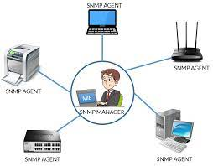
SNMP-Simple Network Management Protocol

Slide 74
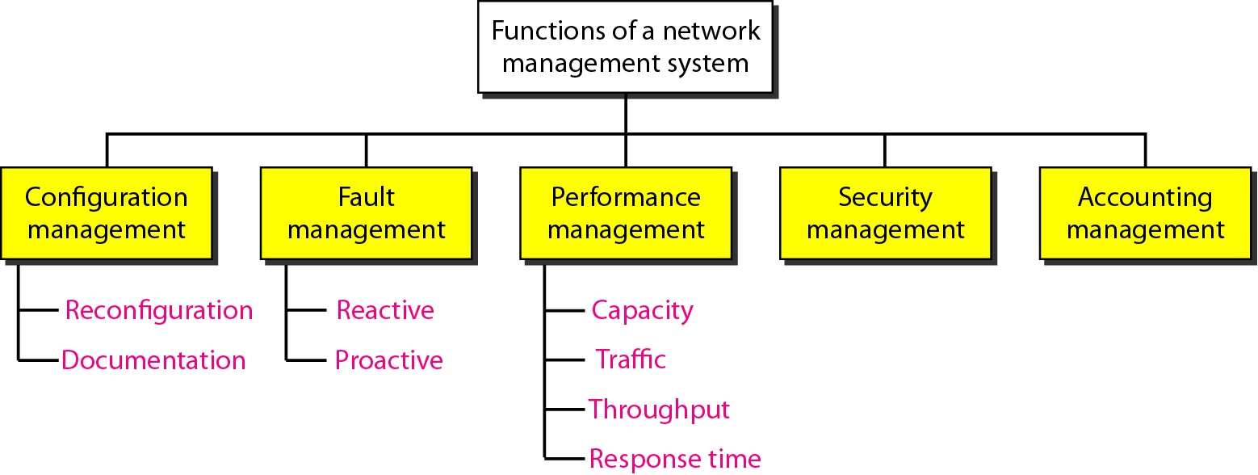
Functions of
Network Management System

Slide 75
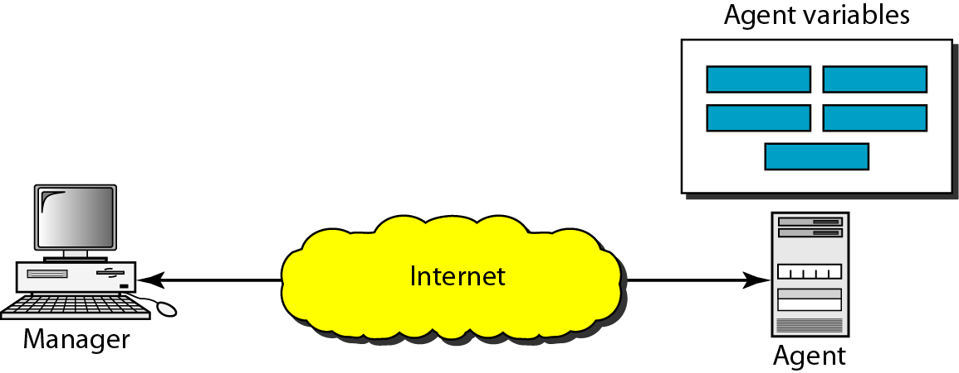
SIMPLE NETWORK MANAGEMENT
PROTOCOL (SNMP)
• A framework for managing devices in an internet using the TCP/IP protocol suite.
It provides a set of fundamental operations for monitoring and maintaining an internet.

Slide 76
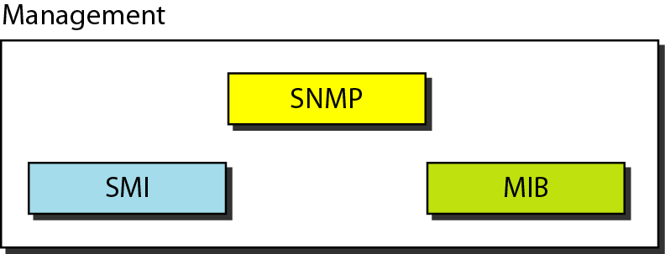
Concept of SNMP
SNMP defines the format of packets exchanged between a manager and an agent.
It reads and changes the status (values) of objects (variables) in SNMP packets

Slide 77
SMI –Structure of Management Information
• Variables recognized by device supplied in MIB (Management Information Base)
• text file giving variables and data structures defined using ASN.1
• standard variable sets often provided as RFC’s
• device-specific sets provided by vendors
• Management stations parse MIB’s to determine variables available for management
• obtain both data structure and management information
Notes:
The term information and communications technology (ICT) is generally accepted to mean all the technologies that, combined, allows people and organisations to interact in the digital world.

Slide 78
Concept of SNMP
The task of network management can be compared to the task of writing a program.
Both tasks need rules. In network management this is handled by SMI.
Both tasks need variable declarations. In network management this is handled by MIB.
Both tasks have actions performed by statements. In network management this is handled by SNMP.

Slide 79
Concept of SNMP
SMI defines the general rules for naming objects, defining object types (including range and length), and showing how to encode objects and values.
SMI does not define the number of objects an entity should manage or name the objects to be managed or define the association between the objects and their values.
MIB creates a collection of named objects, their types, and their relationships to each other in an entity to be managed.

Slide 80
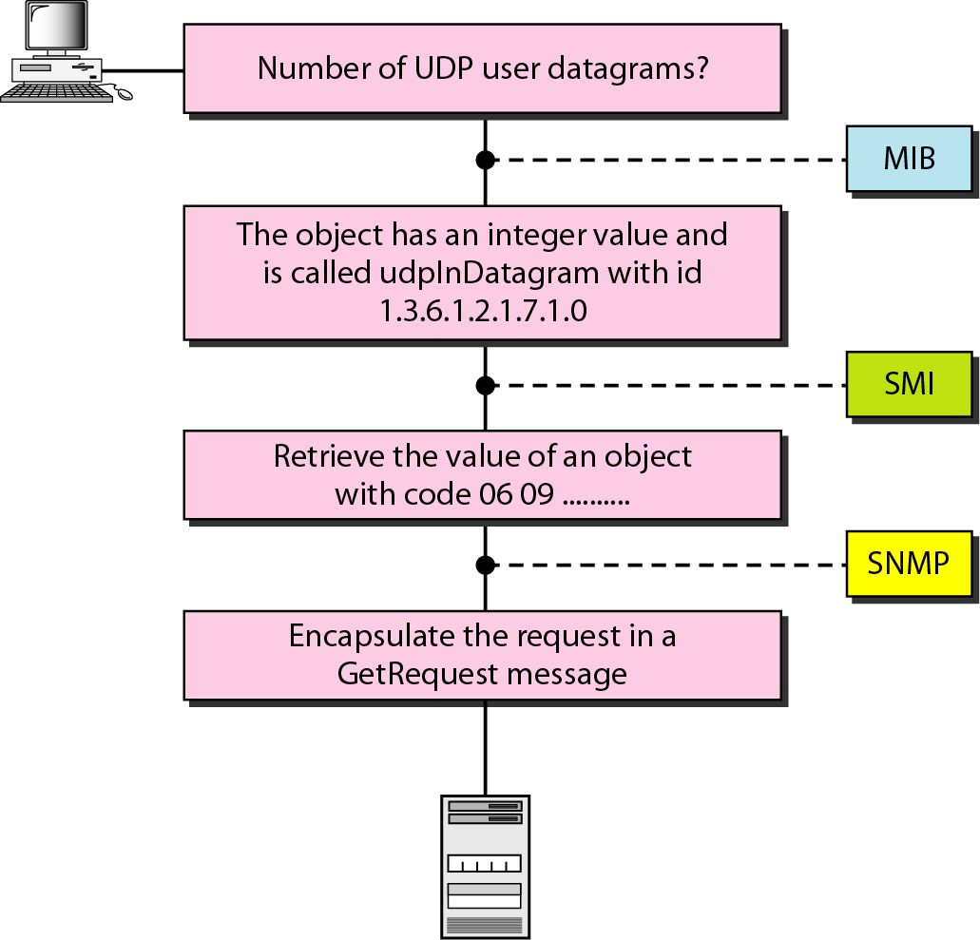
Management overview

Slide 81
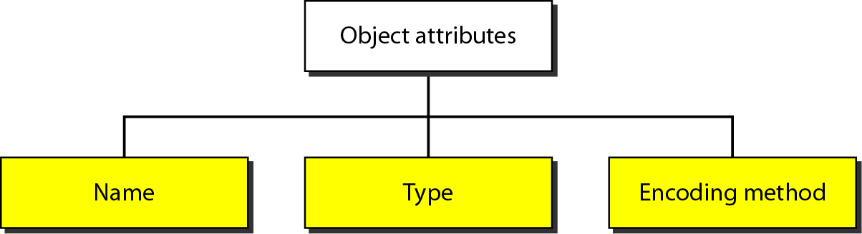
Object attributes

Slide 82
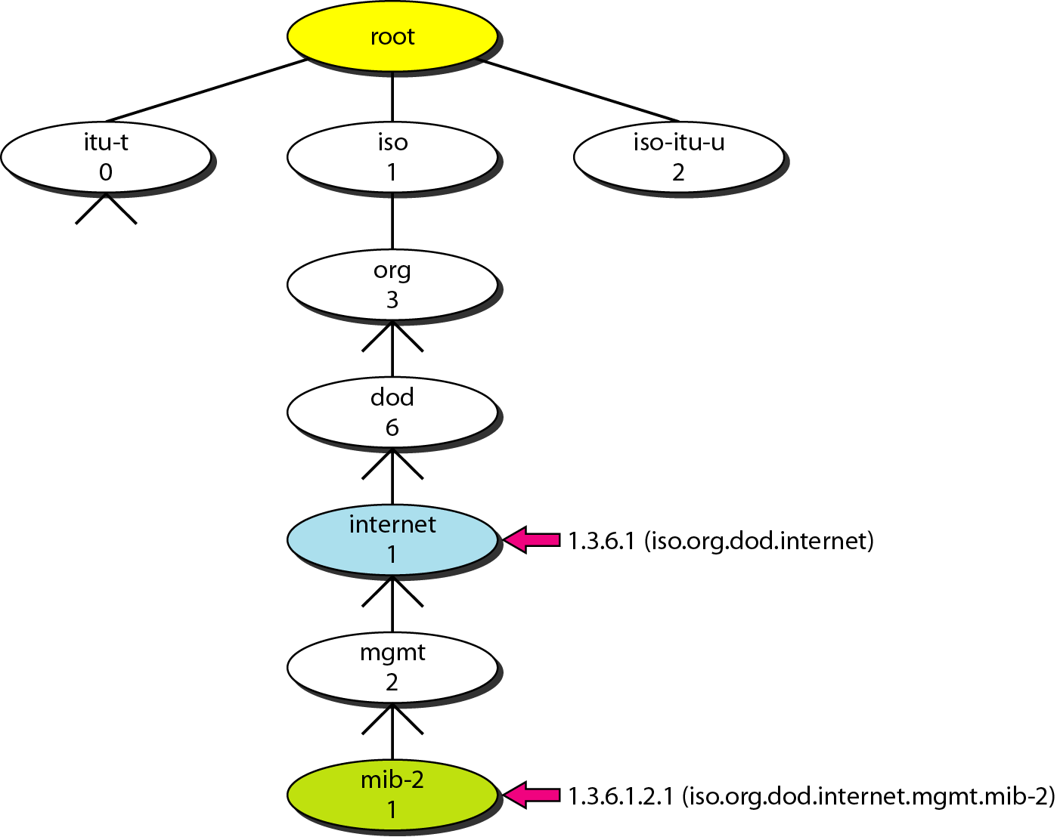
Object identifier
All objects managed by SNMP are given an object identifier.
The object identifier always starts with 1.3.6.1.2.1.

Slide 83
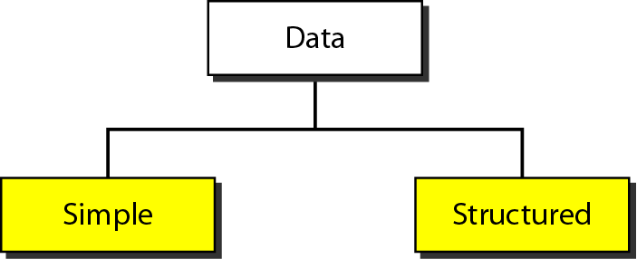
Data Type

Slide 84
Data Type

Slide 85
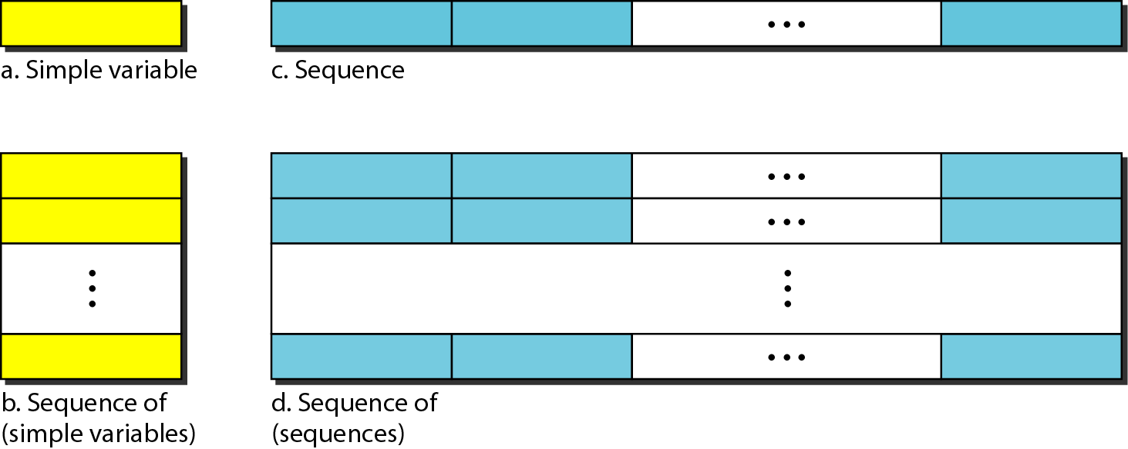
Conceptual Data Type

Slide 86
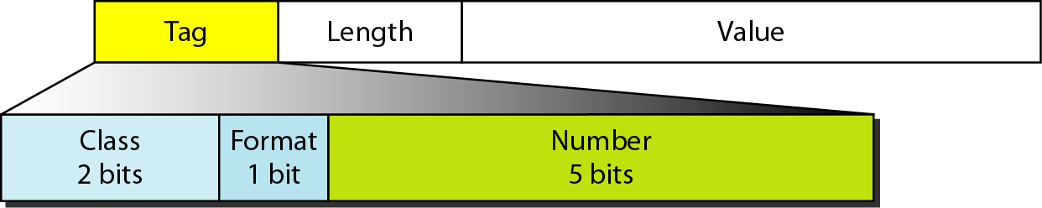
Encoding format

Slide 87
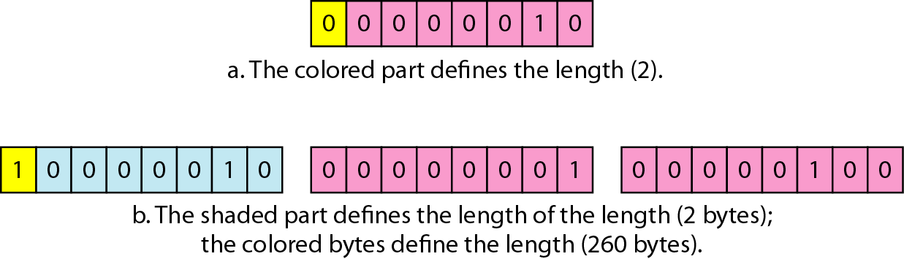
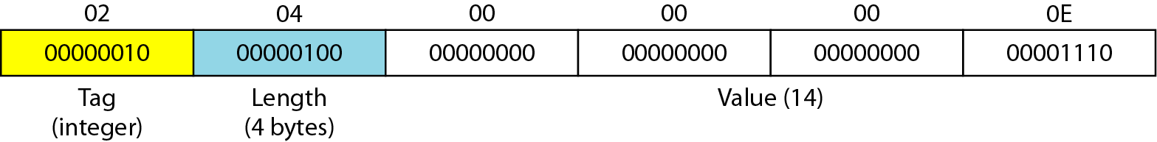
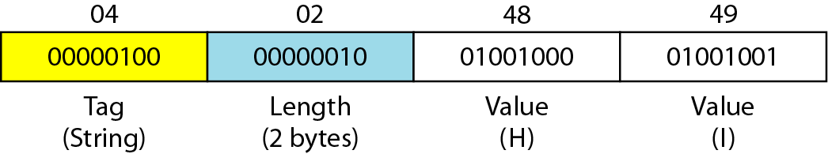
Length format
Example: Integer 14
Example: OCTET STRING “Hi”

Slide 88
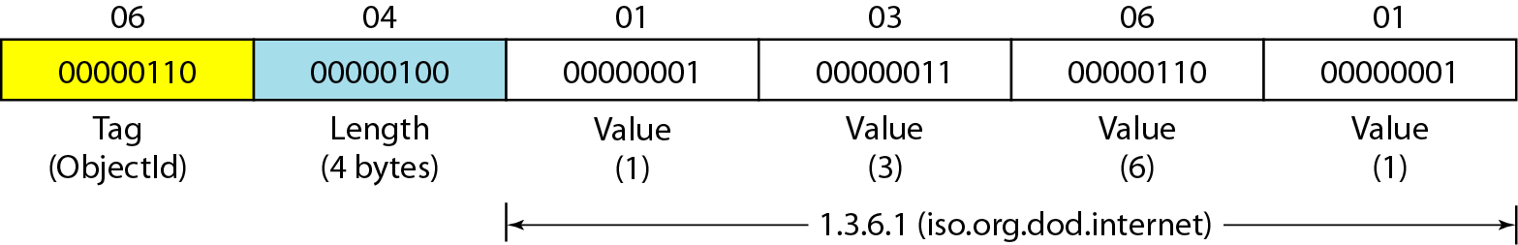
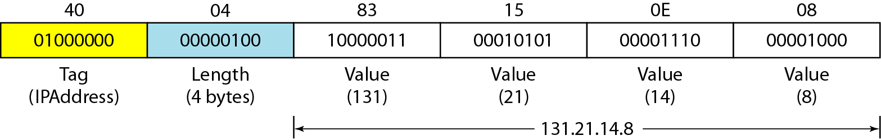
Length format
Example: objectIdentifier 1.3.6.1 (iso.org.dod.internet).
Example: IP address 131.21.14.8

Slide 89
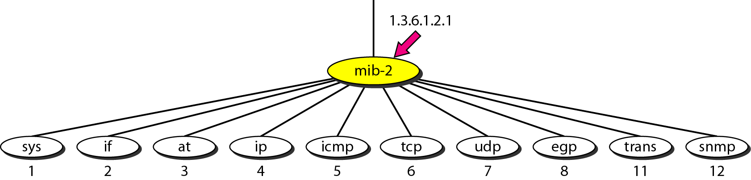
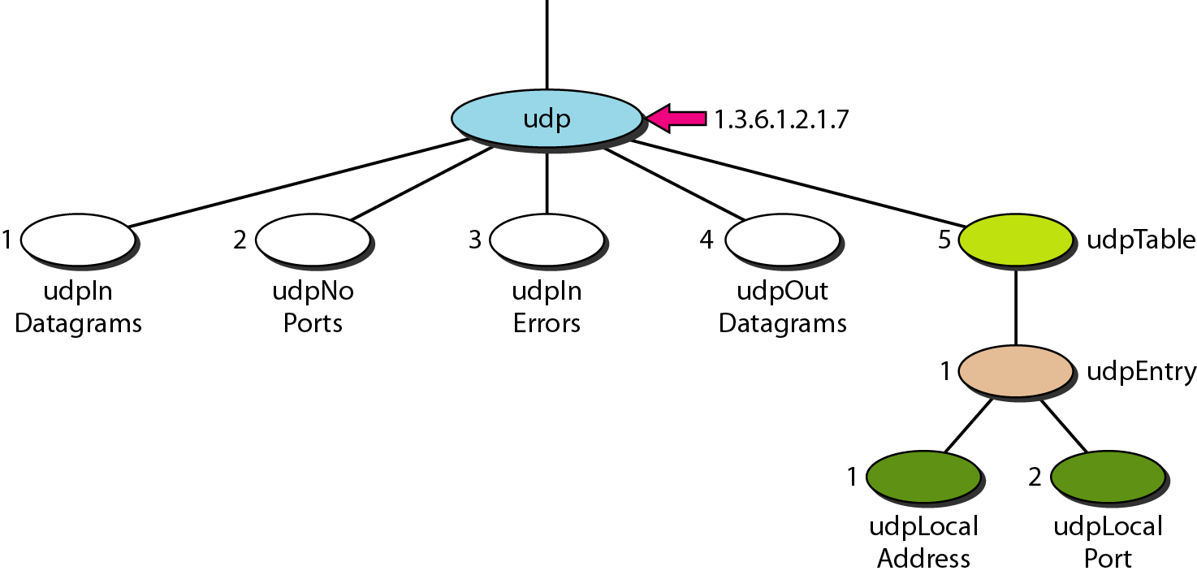
MIB-2
udp group

Slide 90
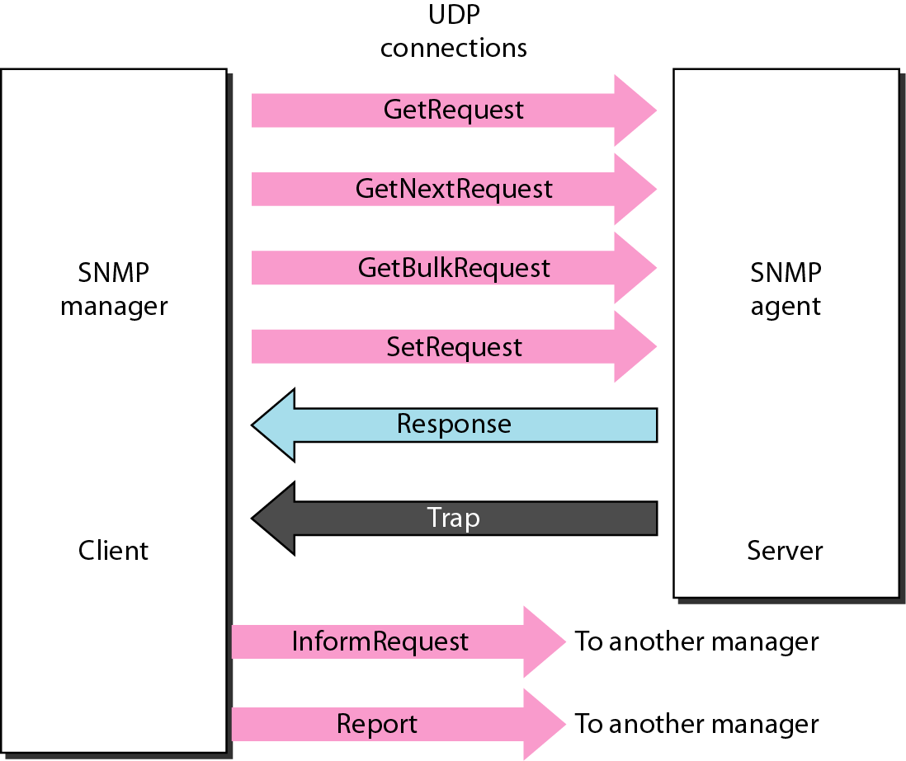
SNMP Protocol Data Unit(PDU)

Slide 91

SNMP Protocol Data Unit(PDU)
Format

Slide 92

SNMP Message

Slide 93
SNMP : Example
A manager station (SNMP client) uses the GetRequest message to retrieve the number of UDP datagrams that a router has received.
There is only one VarBind entity.
The corresponding MIB variable related to this information is udpInDatagrams with the object identifier 1.3.6.1.2.1.7.1.0.
The manager wants to retrieve a value (not to store a value), so the value defines a null entity.
The VarBind list has only one VarBind.

Slide 94
SNMP : Example -contd
The variable is of type 06 and length 09.
The value is of type 05 and length 00.
The whole VarBind is a sequence of length 0D (13).
The VarBind list is also a sequence of length 0F (15).
The GetRequest PDU is of length ID (29).
Now we have three OCTET STRINGs related to the security parameter, security model, and flags.
Then we have two integers defining maximum size (1024) and message ID (64).
The header is a sequence of length 12, which we left blank for simplicity.
There is one integer, version (version 3).
The whole message is a sequence of 52 bytes.

Slide 95

SNMP : Example -contd
Conceptual view of the packet and the hierarchical nature of sequences.

Slide 96

SNMP : Example -contd
Actual message sent by the manager station (client) to the agent (server)

Slide 97

SNMP : Example -contd
Port Numbers for SNMP
Messages use UDP, ports 161 (requests/responses) and 162 (notifications)

Slide 98
Review Questions
Q1. The application-level protocol in which a few manager stations control a set of agents is called ______ a) HTML b) TCP c) SNMP d) SNMP/IP
Q2. To use a Simple Network Management System, we need _______ a) Servers b) IP c) Protocols d) Rules
Q3. SNMP is the framework for managing devices in an internet using the ______ a) TCP/IP protocol b) UDP c) SMTP d) None
Q4. Structure of Management Information (SMI), is the guideline of ________ a) HTTP b) SNMP c) URL d) MIB
Q5. SNMP defines the __________ to be sent from a manager to an agent and vice versa.
Format of packets
Encoding o packets
Number o packets
(b) and (c)

Slide 99
Review Answers
Q1. SNMP
Q2. Rules
Q3.TCP/IP
Q4. SNMP
Q5. Format of Packets

